Slide 1




HANDWRITTEN CHARACTER
RECOGNITION

Slide 2
Introduction
Data Collection and Preprocessing
Model Development and Training
Graphical User Interface Development
Conclusion
Contents

Slide 3



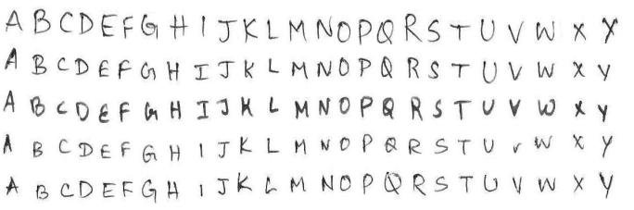

Introduction
In today's digital age, where the exchange of written information is increasingly electronic, the ability to recognize and interpret handwritten characters remains a critical element of bridging the gap between the analog and digital worlds. Handwriting, with its unique personal touch, is a prevalent form of communication that often necessitates conversion into digital text for archiving, analysis, and efficient information retrieval.
In numerous domains, from education and finance to healthcare and administration, documents bearing handwritten characters require accurate and efficient conversion to digital text. Such domains encompass handwritten notes, medical prescriptions, historical archives, and legal documents.
01
Our Solution:
To address the need for handwritten character recognition, our project focuses on the development of a robust Convolutional Neural Network (CNN) model. This CNN model will be designed to recognize and interpret handwritten characters with high accuracy and reliability.

Slide 4


Jambulov Javokhir 12204567
Model Development and Training
Team members
&
roles
Saidmurodov Elyor 12204556
Data Collection and Preprocessing,
testing
Khasanov Abror 12204542
Code implementation,
User Interface and Deployment,
training model

Slide 5

Data Collection
and
Preprocessing
01
02
03

Slide 6


Data Collection
Data collection serves as the cornerstone of our Handwritten Character Recognition project. The quality and diversity of our dataset directly impact the accuracy of our recognition system.
01
Our dataset includes a wide range of characters, encompassing both uppercase and lowercase letters, numbers, and special symbols. This diversity ensures our system's versatility.
To build this dataset, we employed a dual approach, gathering data from publicly available sources and inviting contributions from our team members and volunteers. This comprehensive approach guarantees a robust dataset for training and testing our recognition model.

Slide 7



Labeling and Preprocessing
Labeling and preprocessing are essential steps in preparing our dataset for the recognition model. These steps enable our model to understand and categorize the characters accurately.
02
03
Each character image has been meticulously labeled, associating it with its corresponding character class. Furthermore, we have organized our data into specific categories or folders for each character class.
Image standardization is a key aspect of our preprocessing. All character images have been resized to a uniform resolution (e.g., 28x28 pixels) to maintain consistency. Additionally, pixel values have been normalized to fall within the 0 to 1 range. These measures facilitate efficient model training and reliable recognition.

Slide 8


The correct division of our dataset is pivotal to our project's success. We have split our data into three subsets: a training set, a validation set, and a test set. These subsets serve distinct roles throughout the development process.
Data Split and Quality Assurance
The training set is used to train our recognition model. The validation set assists us in fine-tuning hyperparameters, ensuring optimal model performance. The test set evaluates the final performance of our model.
To enhance dataset diversity, we have also considered optional data augmentation techniques, such as rotation, scaling, and noise addition. Additionally, data quality checks have been conducted to eliminate anomalies, noise, and mislabeled samples, ensuring that our dataset is of the highest quality.

Slide 9
MODEL DEVELOPMENT AND TRAINING:

Slide 10



Model Architecture:
The model architecture phase involves designing the Convolutional Neural Network (CNN) structure, which is a critical component of the handwritten character recognition system. This design includes determining the number of convolutional layers, their respective filter sizes, the presence of pooling layers, fully connected layers, and selecting appropriate activation functions for each layer. Additionally, techniques such as dropout and batch normalization may be employed to enhance the model's ability to generalize and perform well on diverse character inputs.

Slide 11


Deep Learning Framework
The choice of the deep learning framework is a fundamental decision in the project. TensorFlow, a widely recognized framework, is selected due to its strong suitability for image recognition tasks. TensorFlow is known for its scalability, ease of use, and robust community support. Within TensorFlow, Keras, a high-level neural networks API, will be utilized for model development. Keras simplifies the process of designing, training, and evaluating deep learning models, contributing to the project's efficiency.
KPI # 1

Slide 12

Model Training Process
The model training process is a crucial step in achieving a robust handwritten character recognition system. During this phase, the selected CNN architecture will be trained using the prepared dataset. The training process will include specifying the number of training epochs, which determine how many times the entire dataset is passed through the model, and the batch size, which controls the number of samples processed in each training iteration.
To optimize the model's performance, a categorical cross-entropy loss function will be employed.
The Adam optimization algorithm, a popular choice for gradient-based optimization, will be used to adjust the model's parameters during training. Backpropagation, a key technique in deep learning, will be applied to iteratively fine-tune the model.

Slide 13
Timeline
The timeline for the project is as follows:
12-week: Data Collection and Preprocessing
12-week: Model architecture design and finalization.
12-week: Implementation of the CNN in TensorFlow.
13-week: Commencement of model training.
13-week: Model training completion and optimization.
13-week: Development of Graphical User Interface
14-week: Handover of the trained model for integration.
15-week: Completion of the project

Slide 14

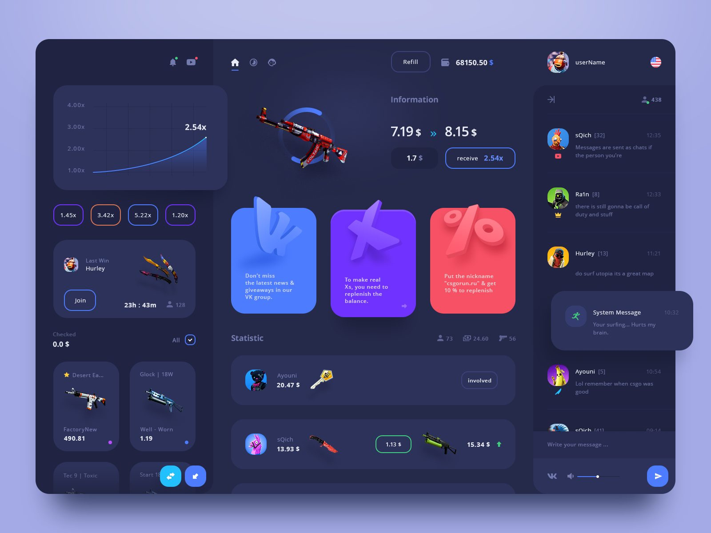
USER INTERFACE
Overview
The UI is a critical component of our Handwritten Character Recognition system, as it serves as the primary point of interaction between users and our recognition model.

Slide 15






Visual Representation of UI
In this slide, we offer a comprehensive visual representation of our meticulously designed user interface
Goal nº 01 UI Layout and Elements:
The layout is clean and uncluttered, with an intuitive arrangement of elements.
A prominent canvas occupies the center of the screen, allowing users to draw handwritten digits effortlessly.
Goal nº 02 Real-time Recognition Display:
The UI seamlessly integrates with our Convolutional Neural Network (CNN) model for real-time character recognition.
As users draw digits on the canvas, the system immediately processes the input and provides recognition results in real time.
Goal nº 03 Intuitive User Guidance:
The UI provides clear instructions to guide users through the recognition process.
Tooltips and pop-up hints offer additional information as users hover over icons and buttons.
An on-screen tutorial is available for new users to learn how to use the system effectively.

Slide 16


Key Features and Functionalities
These well-crafted features not only enhance the accuracy and efficiency of our Handwritten Character Recognition system but also empower users with a seamless and engaging interaction with the technology.
Character Drawing
These features contribute to a seamless and efficient user experience, making our system accessible to a broad audience.
Real-time Recognition
Key features that UI is equipped with
Clear and Reset
Accessibility

Slide 17
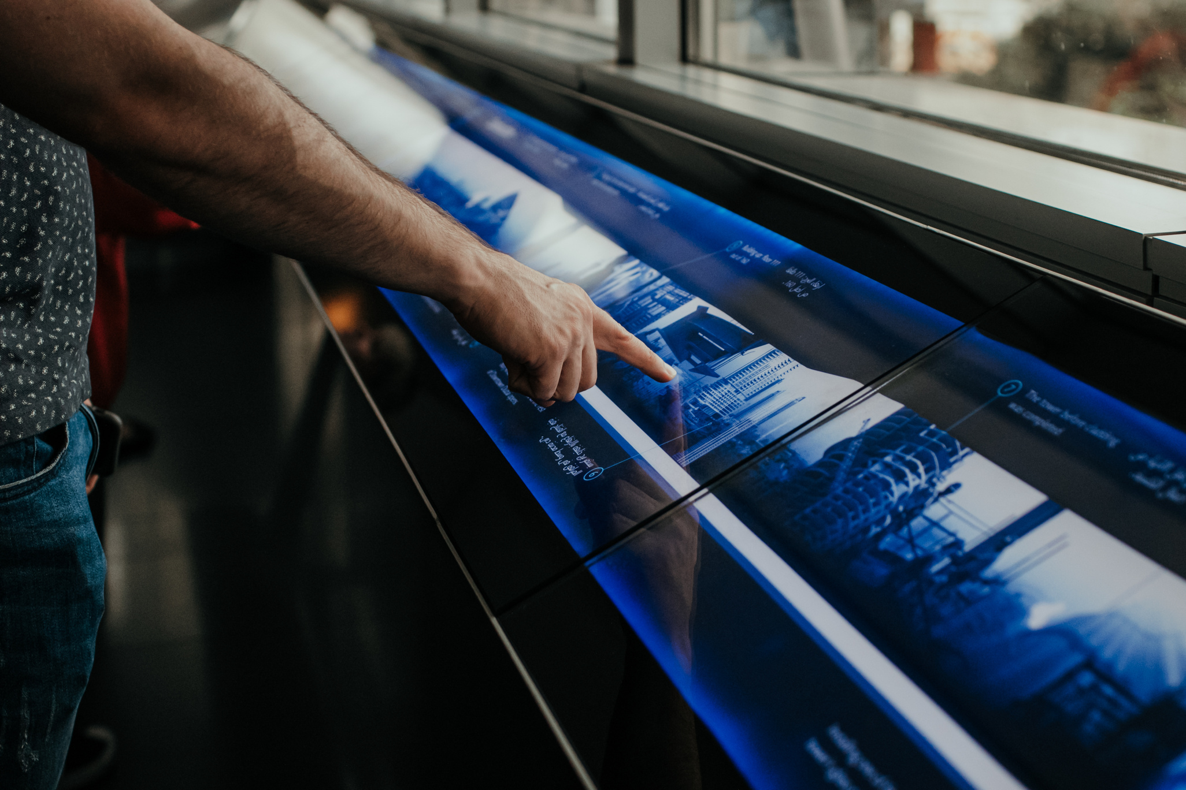
User-Friendliness and Ease of Use
UI design prioritizes user-friendliness and ease of use. We have meticulously crafted the following aspects to achieve this goal:
01
02
03
04
Clear Instructions: The UI provides clear and concise instructions, ensuring that users can easily understand how to interact with the system.
Responsive Design: The UI is responsive and adapts to various screen sizes, guaranteeing a consistent experience on different devices.
User Testing:
To ensure the utmost user-friendliness, we have conducted user testing and incorporated user feedback into our design.
Intuitive Layout:
The layout is designed to guide users through the character recognition process effortlessly.

Slide 18

In our collaborative project on Handwritten Character Recognition, three major roles have seamlessly come together. Data Collection and Preprocessing established a diverse, high-quality dataset as the foundation. Model Development and Training crafted a potent convolutional neural network (CNN) for character recognition. User Interface and Deployment brought our project to life with an interactive system for real-time character recognition. Together, we've created a versatile and impactful Handwritten Character Recognition system, showcasing the power of teamwork in the world of AI and deep learning. Thank you for your attention, and we look forward to demonstrating our system's capabilities
CONCLUSION

Slide 19
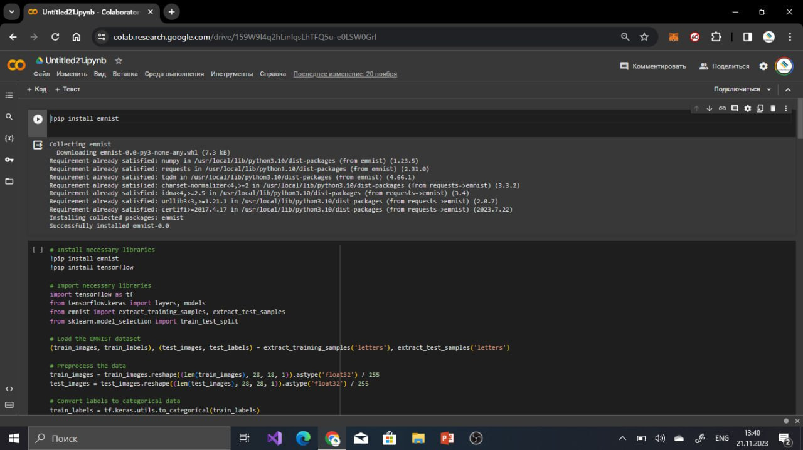
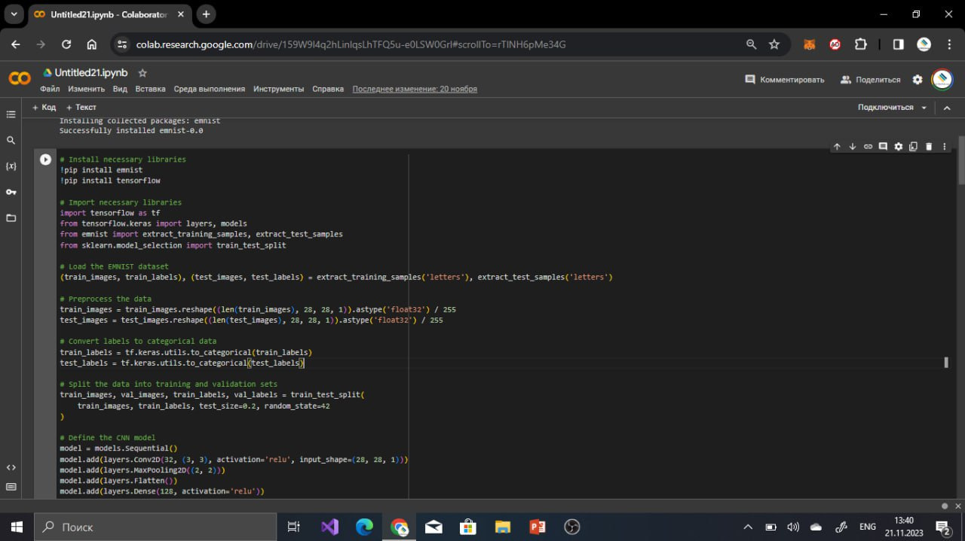
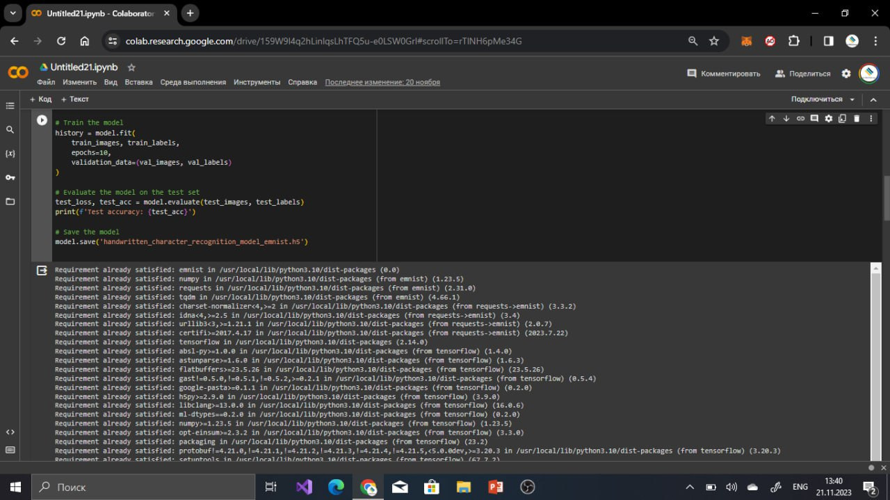
Coding
of
Hand Written Character Recognition

Slide 20
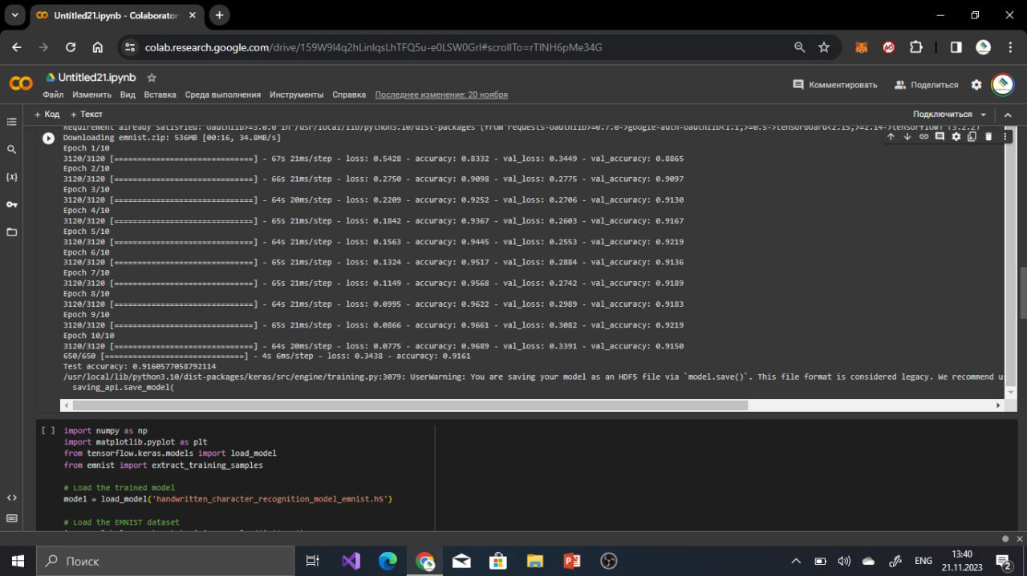
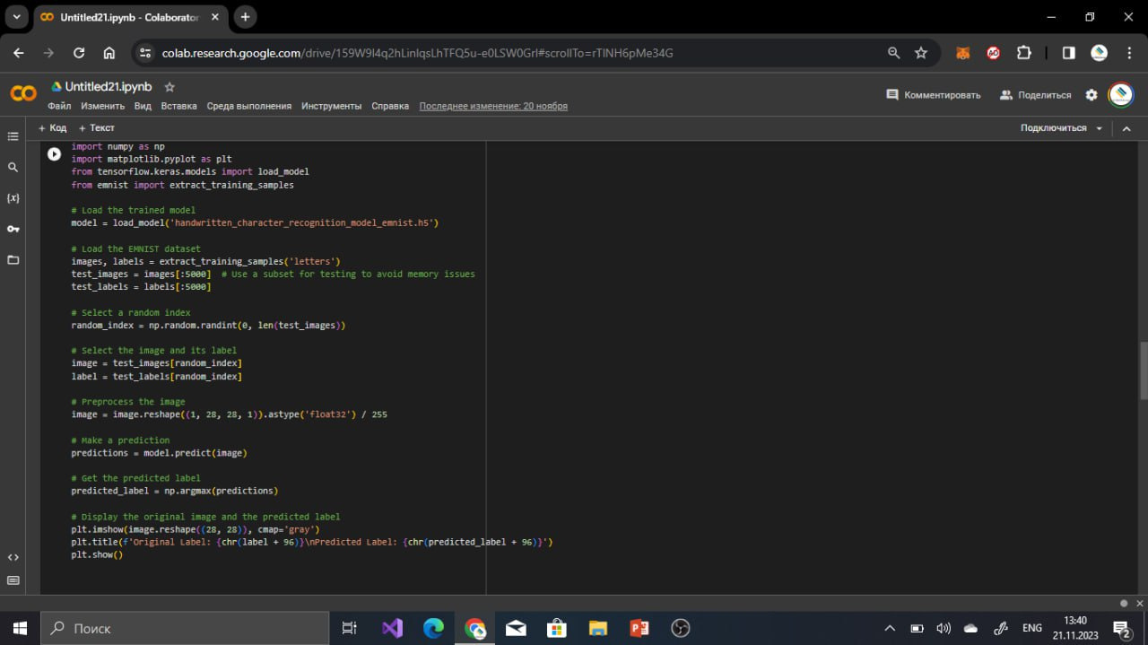
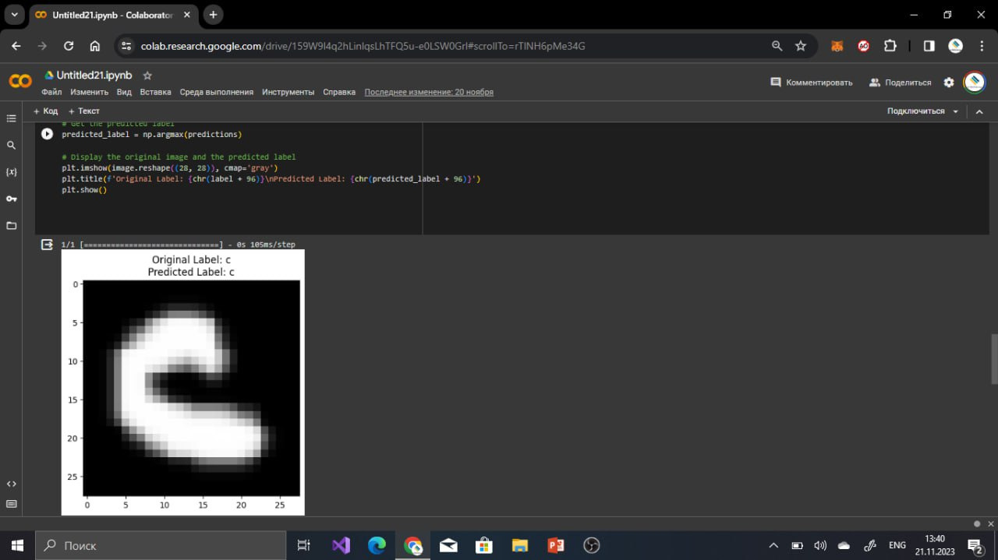
Coding
of
Hand Written Character Recognition

Slide 21
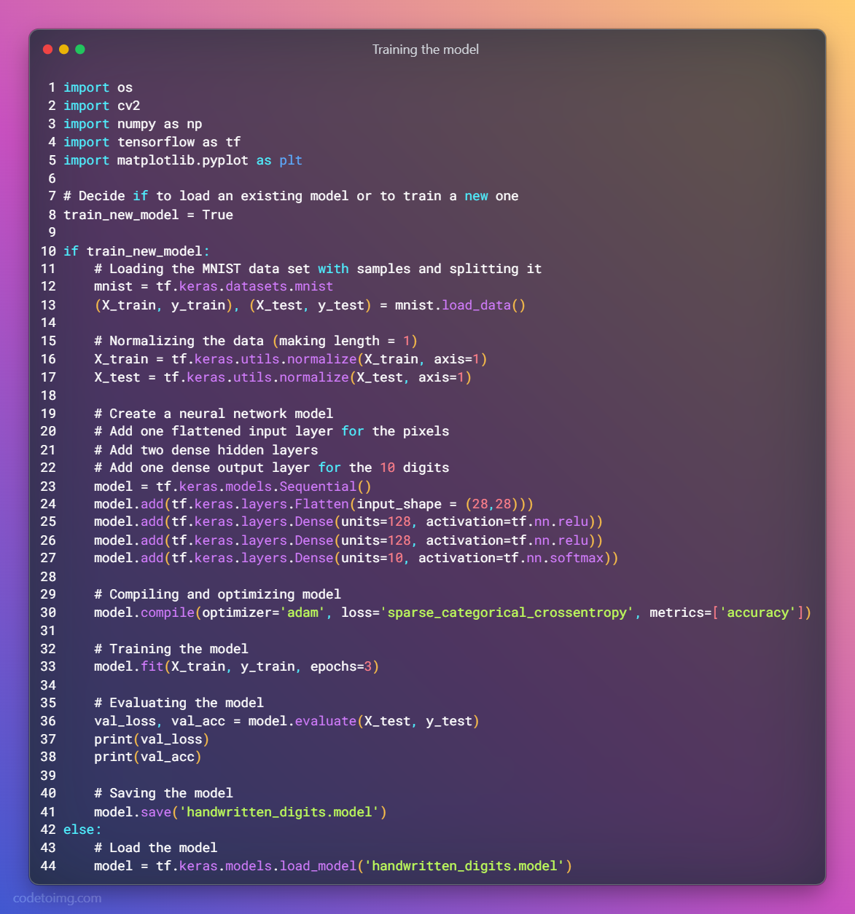
Coding
of
Hand Written DIGIT
Recognition

Slide 22
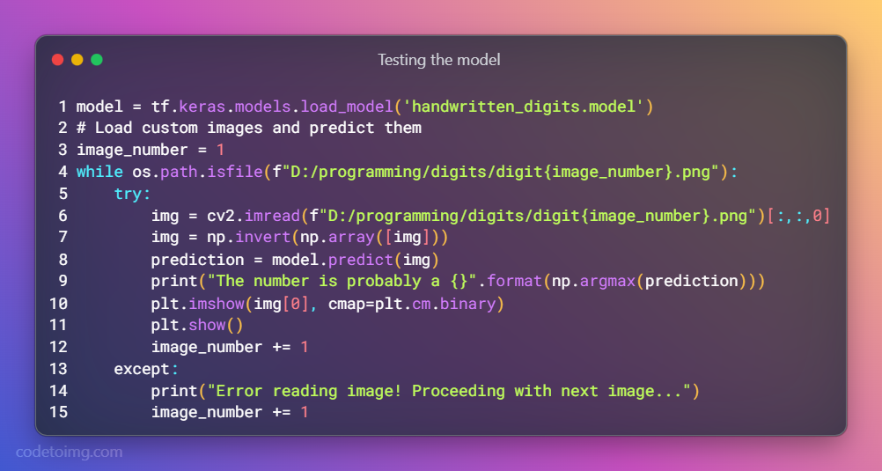
Coding
of
Hand Written DIGIT
Recognition

Slide 23
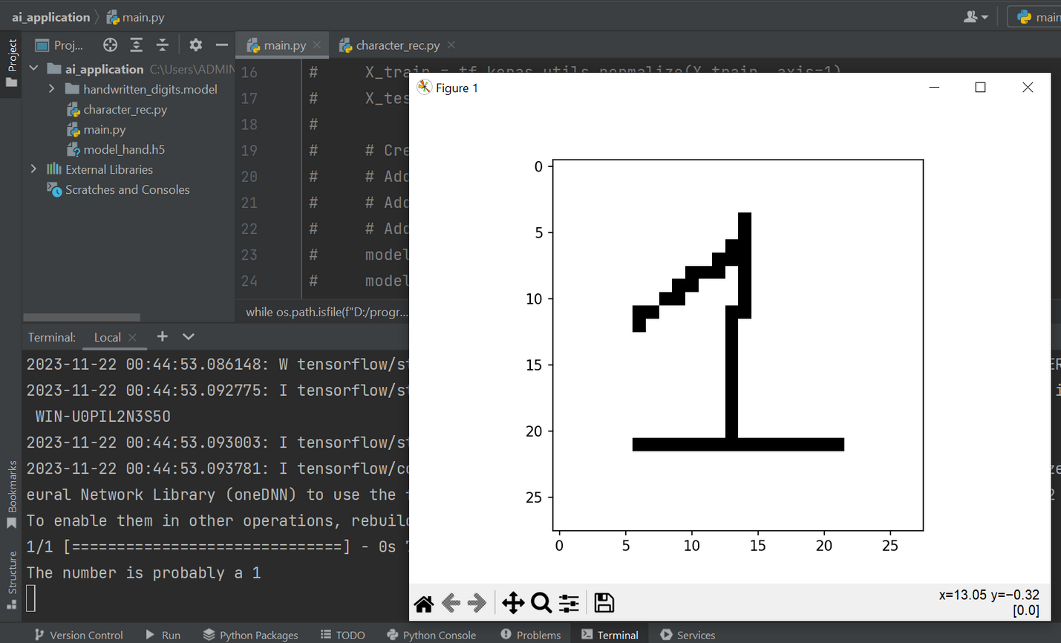
Output
of
Hand Written DIGIT
Recognition

Slide 24
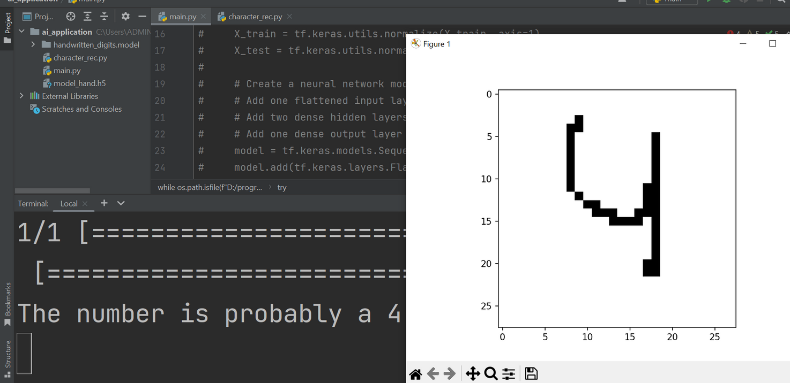
Output
of
Hand Written DIGIT
Recognition

Slide 25
HANDWRITTEN
Text
RECOGNITION
Week 15

Slide 26

Khasanov Abror 12204542
Dataset preparation,
Dataset processing
Team members
&
roles
Saidmurodov Elyor 12204556
Model & Training model
and
merging the codes
Jambulov Javokhir 12204567
Model creation and data preprocessing
GUI integration

Slide 27

Support various handwritten communications
Handwritten Text Recognition (HTR)
Digitization of historical documents
Use Cases
Automate data extraction
hello world
Aid educational endeavors by organizing notes and assisting ingraining
Facilitate document authentication
hello world
Streamline administrative tasks by
processing handwritten forms
Khasanov Abror 12204542

Slide 28
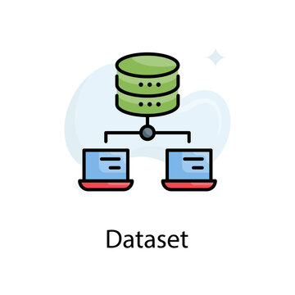


The IAM Handwriting Database contains forms of handwritten English text which can be used to train and test handwritten text recognizers and to perform writer identification and verification experiments
IAM Handwriting Database
The database contains forms of unconstrained handwritten text, which were scanned at a resolution of 300dpi and saved as PNG images with 256 gray levels.
https://fki.tic.heia-fr.ch/databases/iam-handwriting-database
Khasanov Abror 12204542

Slide 29
The IAM Handwriting Database 3.0 is structured as follows
657 writers contributed samples of their handwriting
1'539 pages of scanned text
5'685 isolated and labeled sentences
13'353 isolated and labeled text lines
115'320 isolated and labeled words
IAM Handwriting Database
Khasanov Abror 12204542

Slide 30
Text Recognition
Image Preprocessing
Build CNN Model
Training
Load the image and resize it to a fixed size.
Normalize pixel values to be between 0 and 1.
Use a simple CNN architecture with convolutional and pooling layers.
Flatten the output and add a dense layer for classification.
Split the dataset, choose a loss function, and train the model on the training set
Prediction
Post-Processing
Use the trained model to predict text from new images.
Implement decoding to convert model predictions into human-readable text.
Khasanov Abror 12204542

Slide 31

Text Recognition
Khasanov Abror 12204542

Slide 32
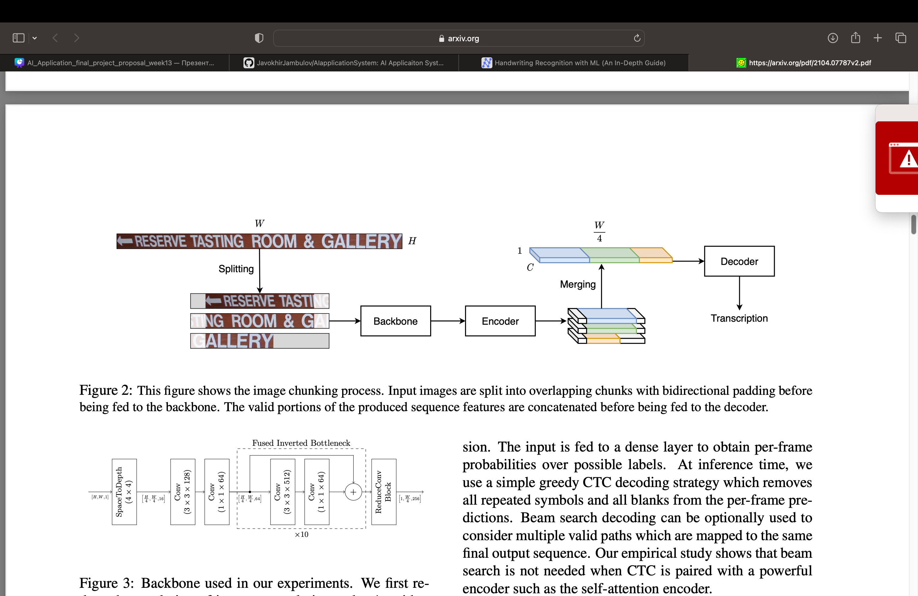

FLOWCHART
Khasanov Abror 12204542

Slide 33
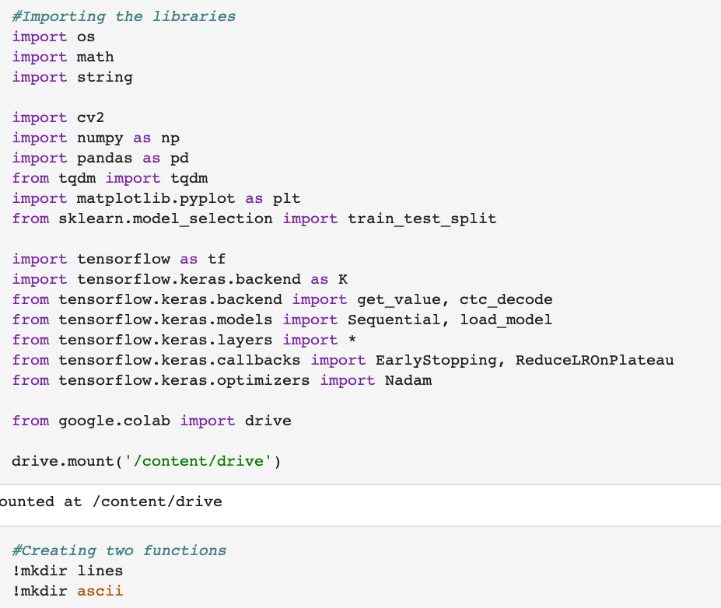
Libraries
Khasanov
Abror
Khasanov Abror 12204542

Slide 34
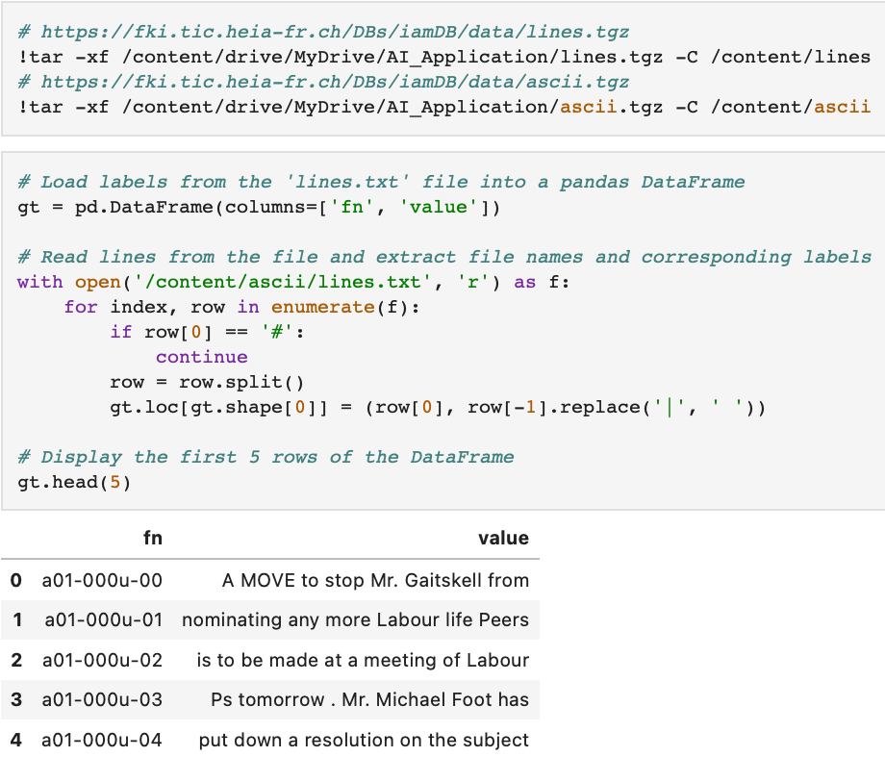
DATASET
Khasanov
Abror
Khasanov Abror 12204542

Slide 35
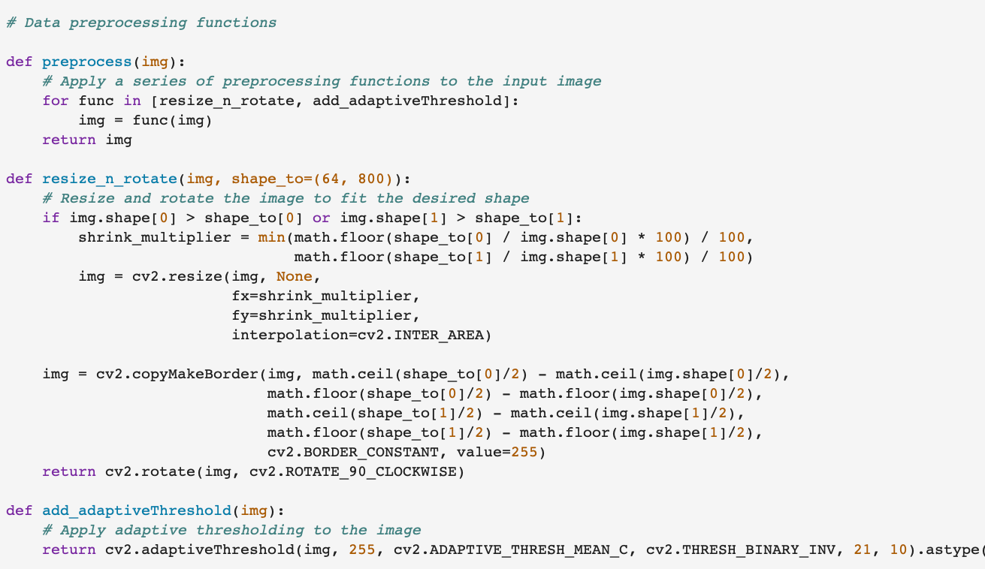
Data Processing
Khasanov Abror 12204542

Slide 36
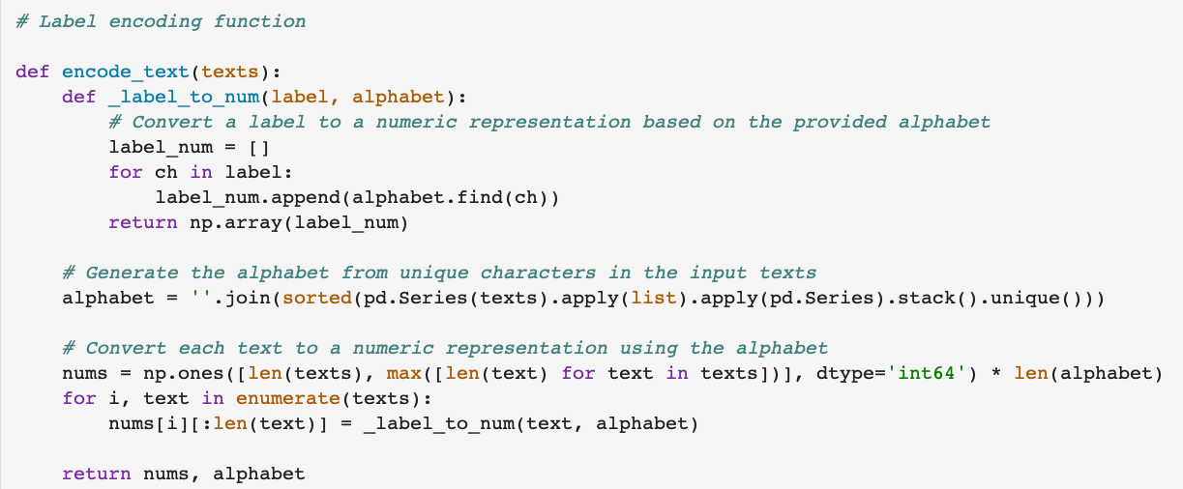
Data Processing
Khasanov Abror 12204542

Slide 37
DATASET
Preprocessing
Jambulov Javohir

Slide 38
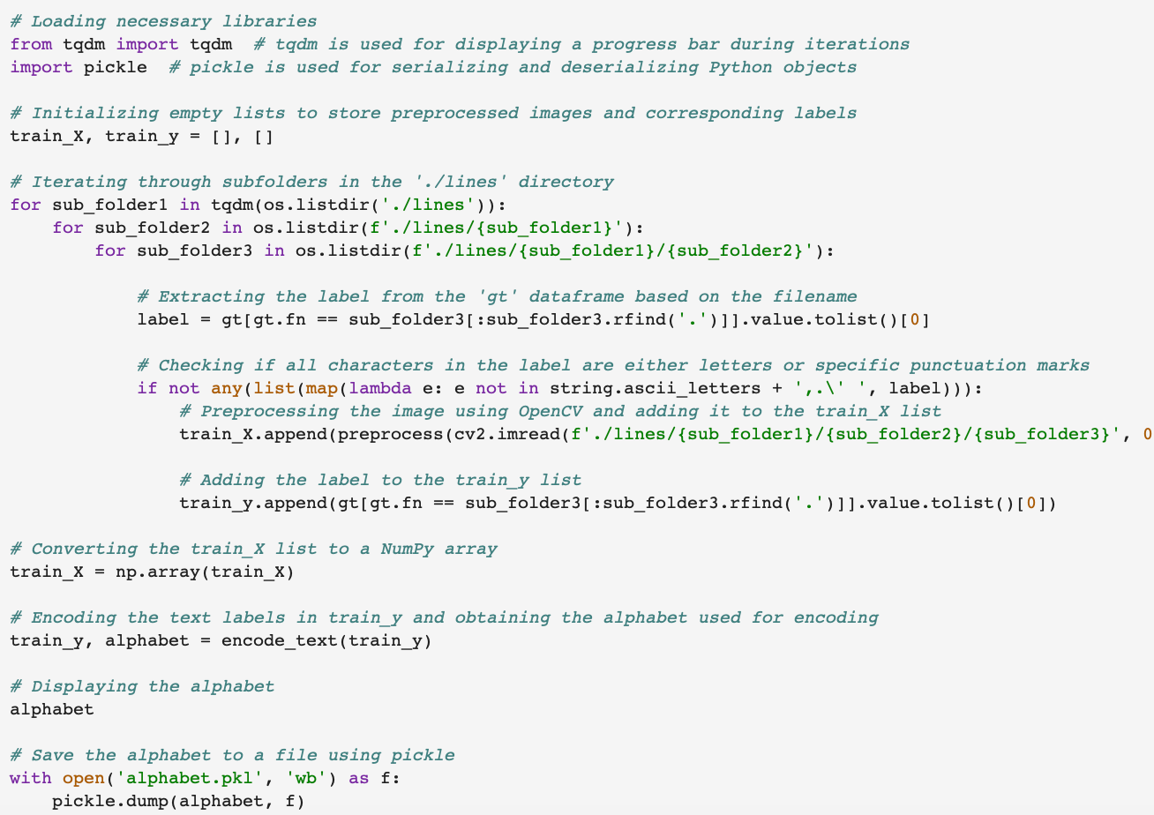
Data Preprocessing
Jambulov Javokhir 12204567

Slide 39
Data Preprocessing
Processing
Data
Javokhir
Jambulov Javokhir 12204567

Slide 40
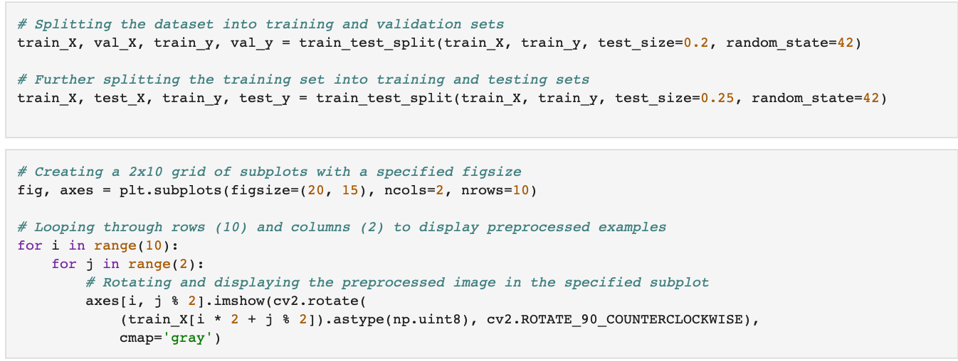
Data Preprocessing
Jambulov Javokhir 12204567

Slide 41
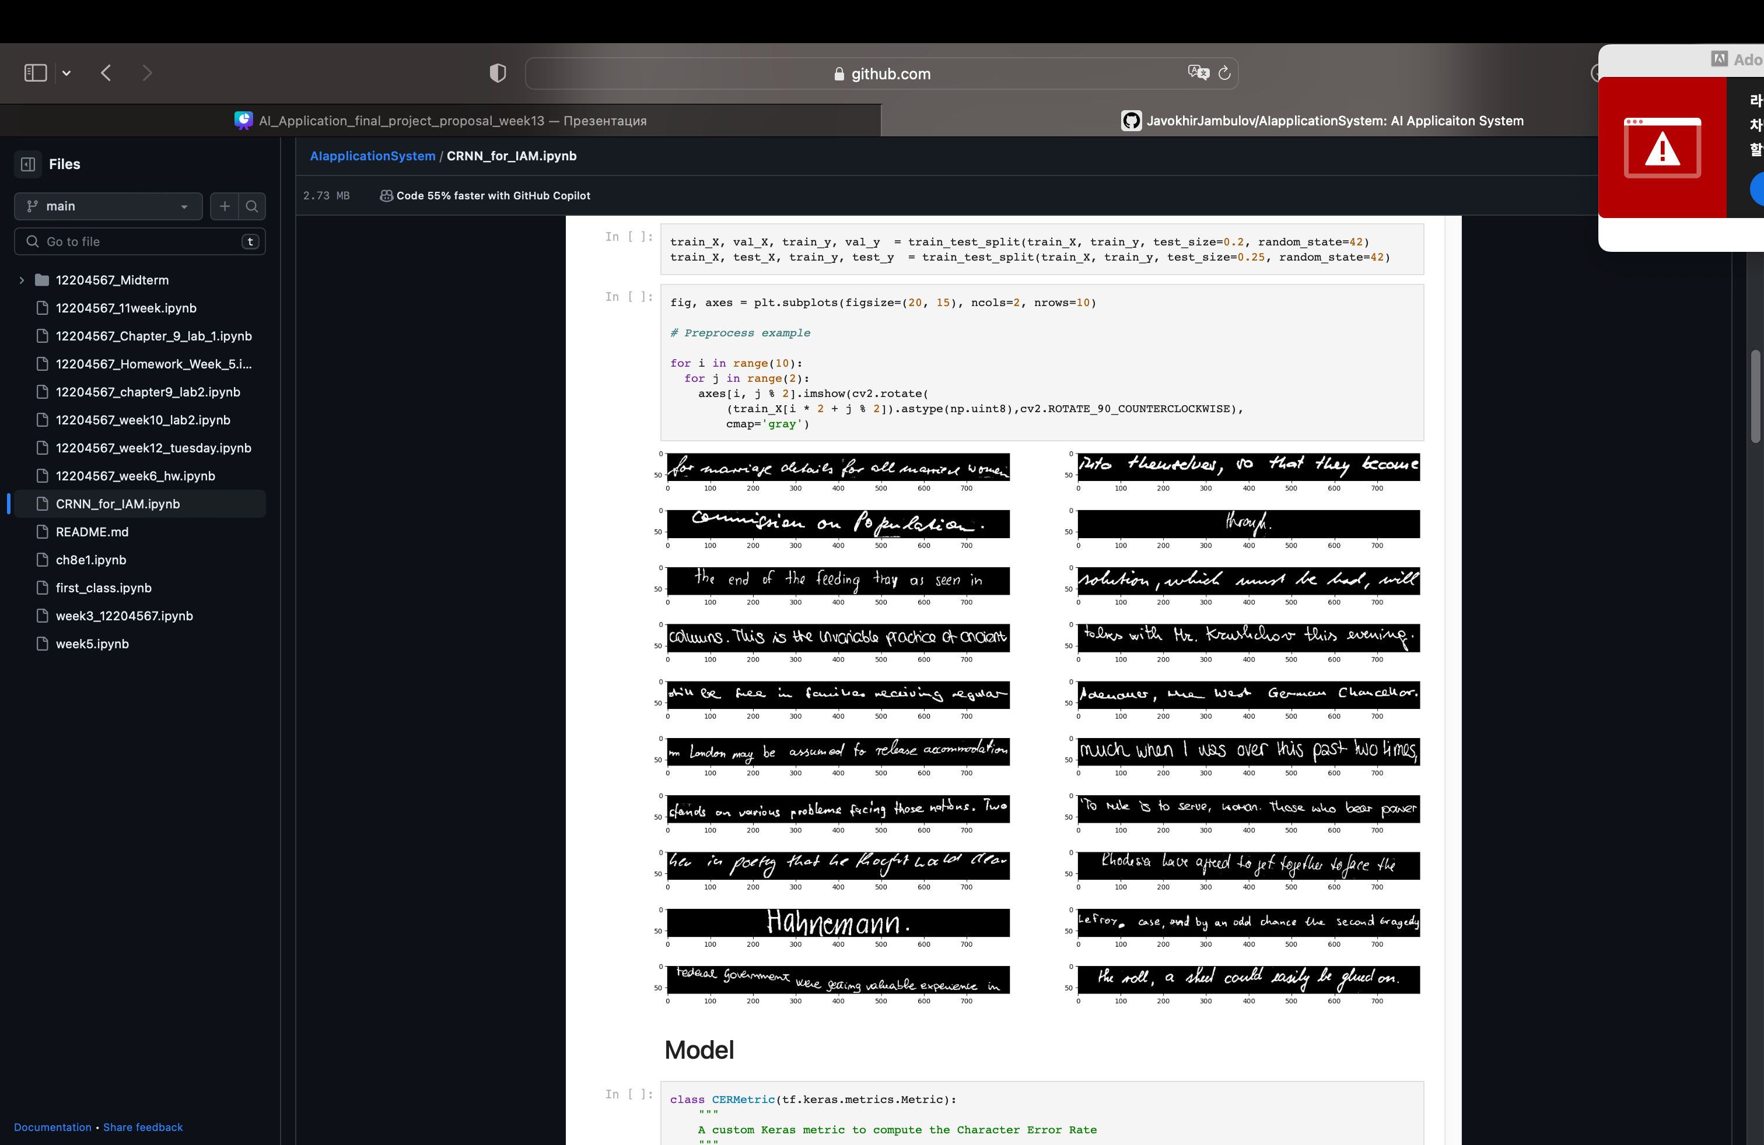
Data Preprocessing
Jambulov Javokhir 12204567

Slide 42
Model
Saidmurodov Elyor

Slide 43
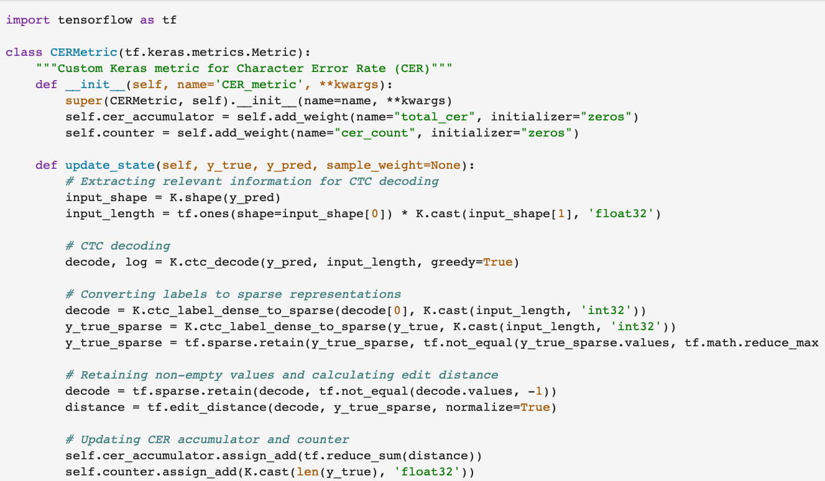
Model
Saidmurodov Elyor 12204556

Slide 44
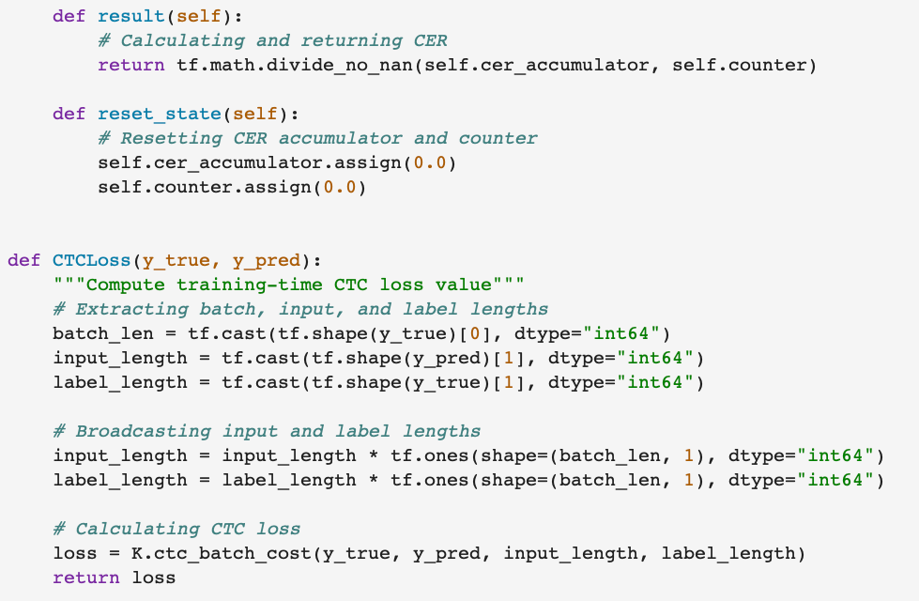
Model
Saidmurodov Elyor 12204556

Slide 45
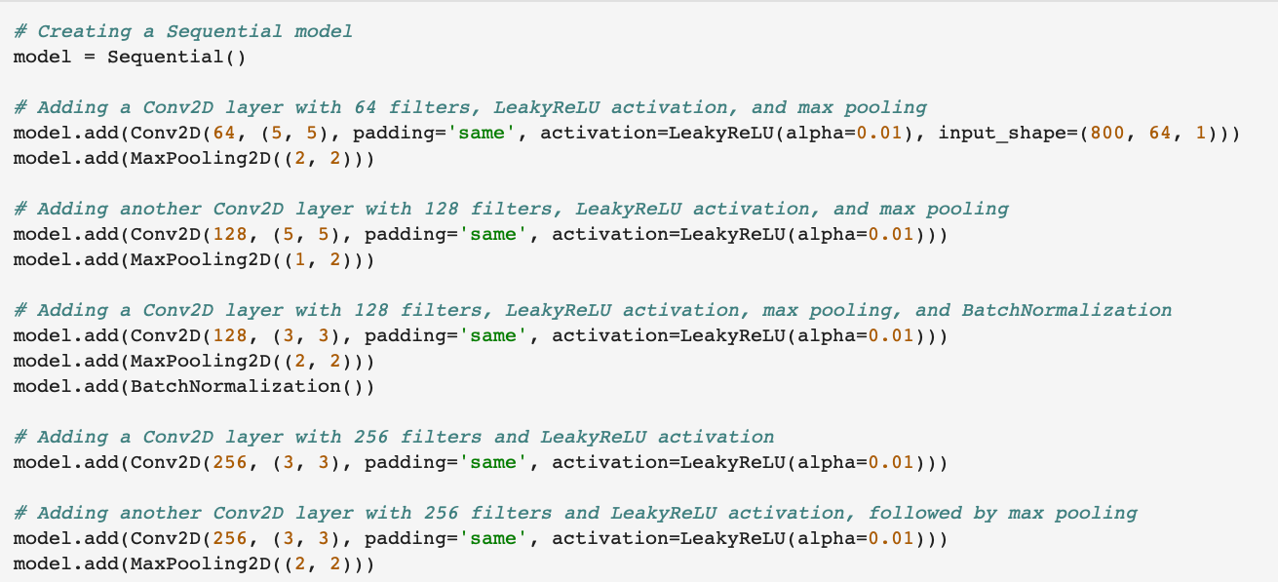
Model
Saidmurodov Elyor 12204556

Slide 46
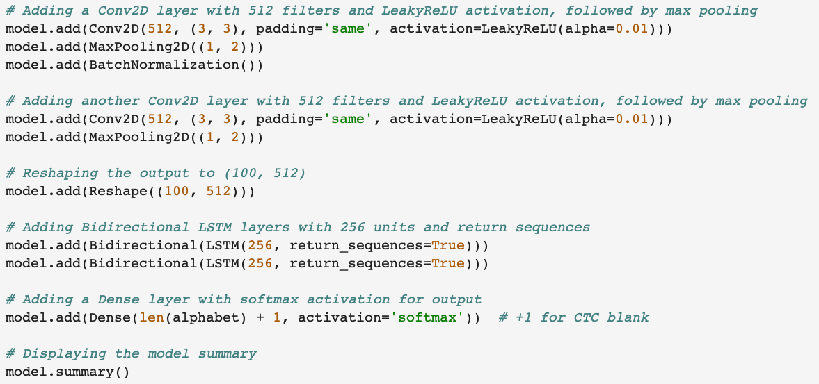
Model
Saidmurodov Elyor 12204556

Slide 47
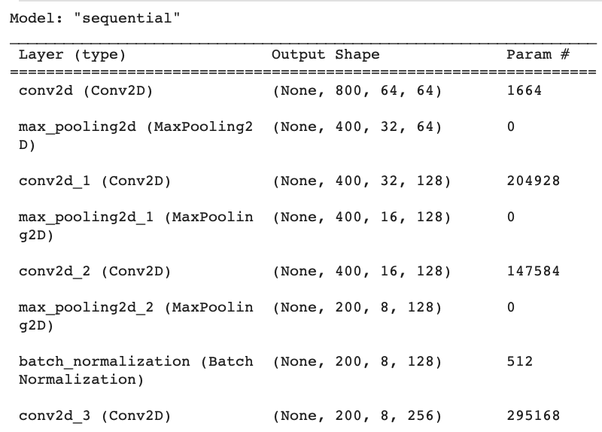
Model
Saidmurodov Elyor 12204556

Slide 48
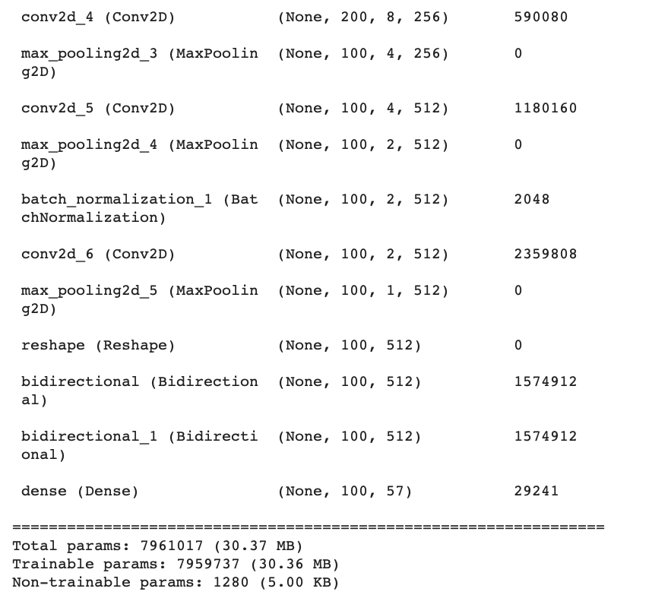
Model
Saidmurodov Elyor 12204556

Slide 49
Training Model
Saidmurodov Elyor

Slide 50
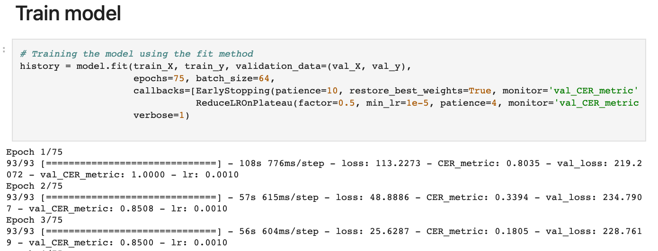
TrainingModel
Training
Model
Saidmurodov
Elyor
Saidmurodov Elyor 12204556

Slide 51
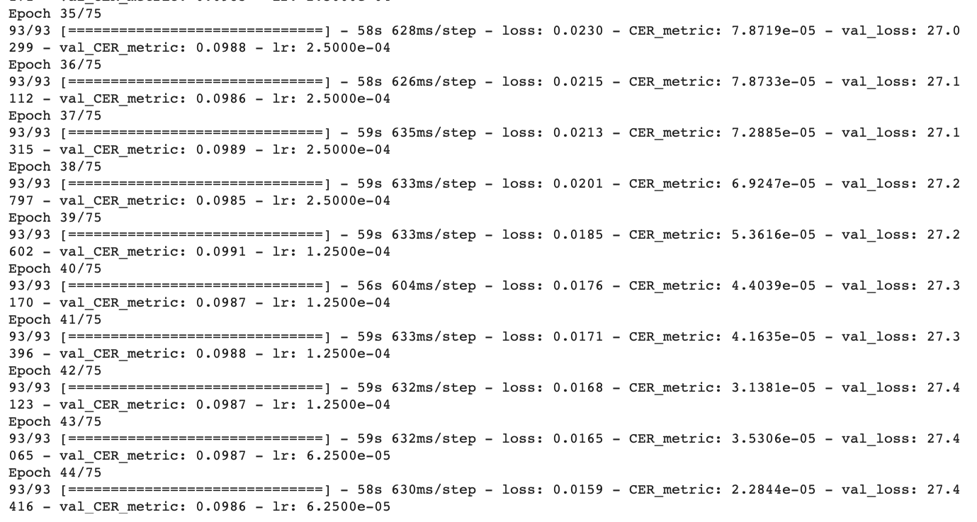
TrainingModel
Training
Model
Saidmurodov
Elyor
Saidmurodov Elyor 12204556

Slide 52
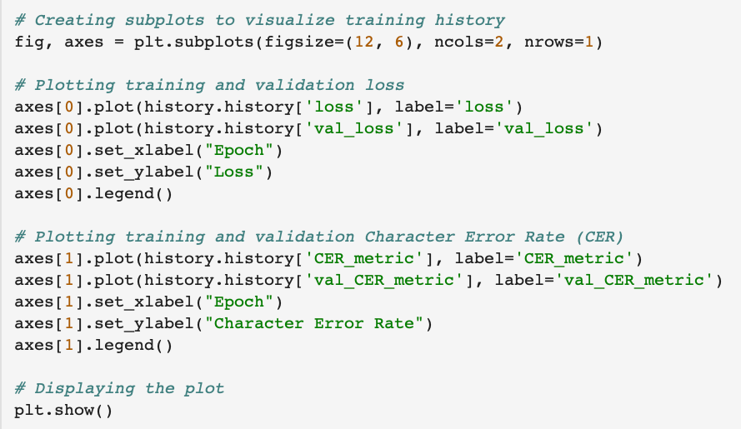
TrainingModel
Training
Model
Saidmurodov
Elyor
Saidmurodov Elyor 12204556

Slide 53
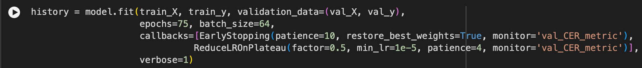
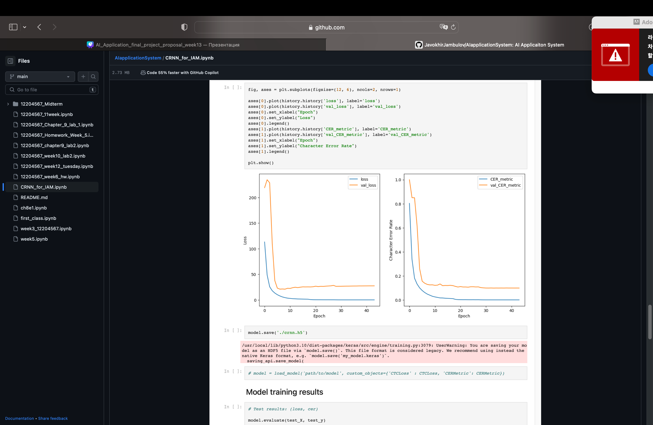
Batch size
=
64
Training
Model
Saidmurodov
Elyor

Slide 54
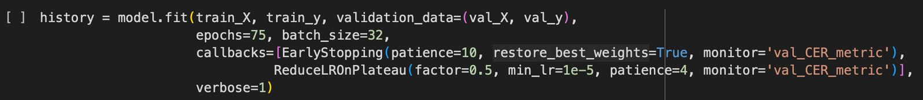
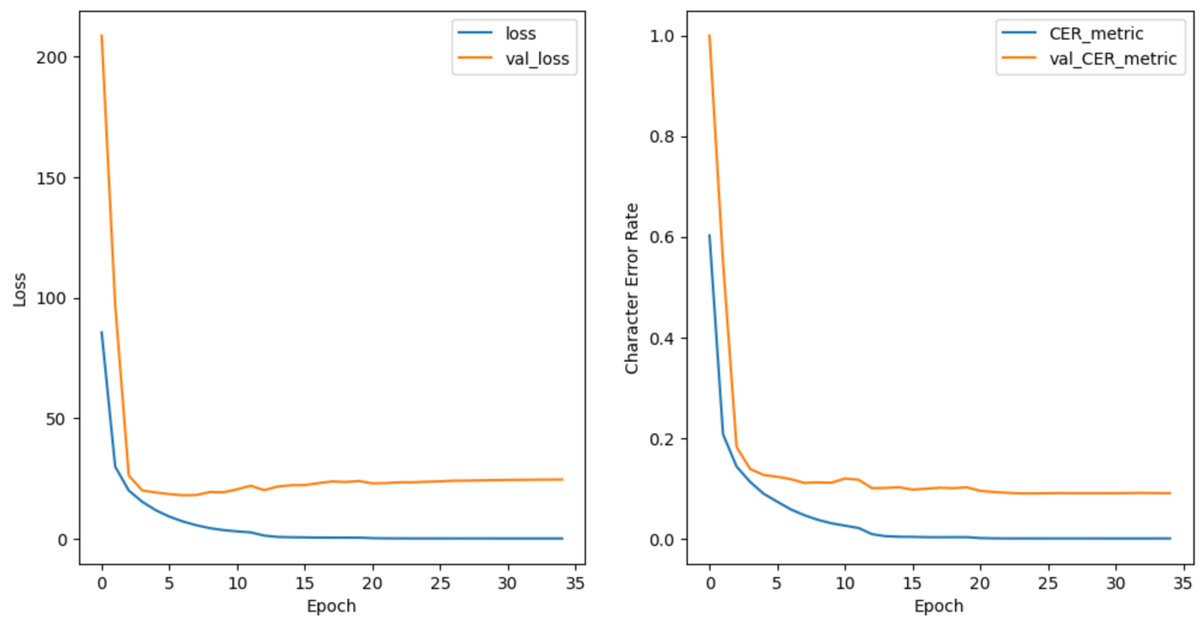
Batch size
=
32
Training
Model
Saidmurodov
Elyor

Slide 55
Training model results
Jambulov Javohir

Slide 56
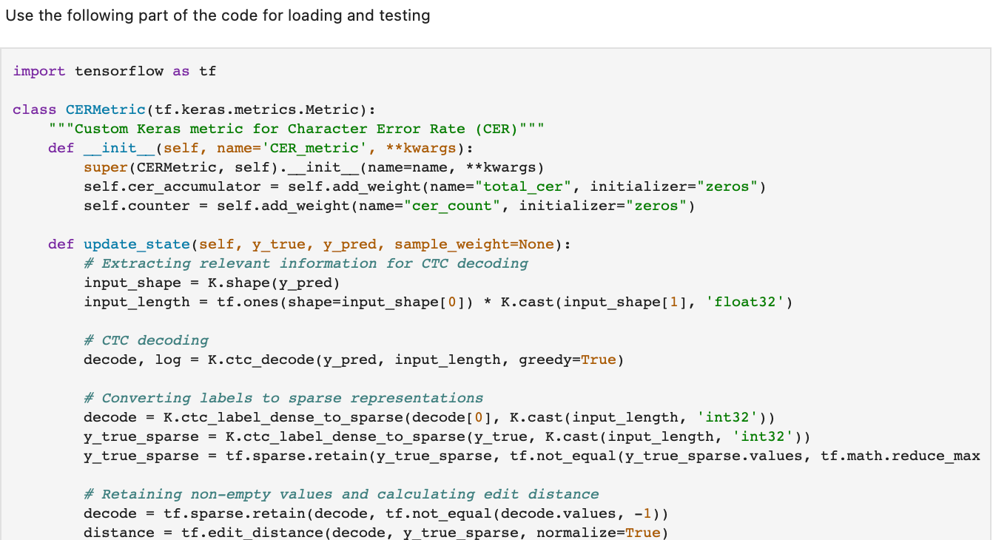
TrainingModel
results
Jambulov Javokhir 12204567

Slide 57
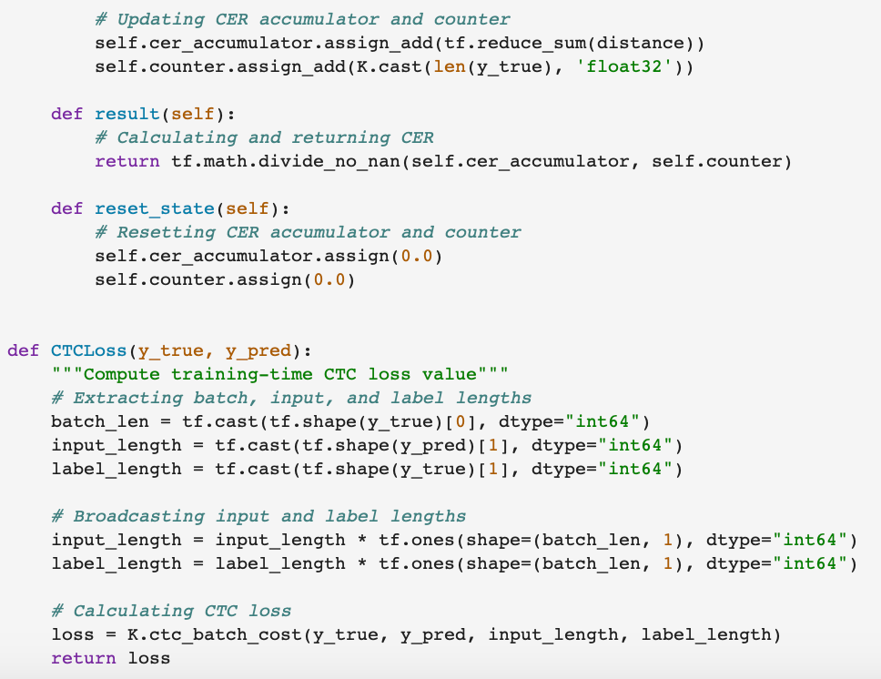
TrainingModel
results
Jambulov Javokhir 12204567

Slide 58
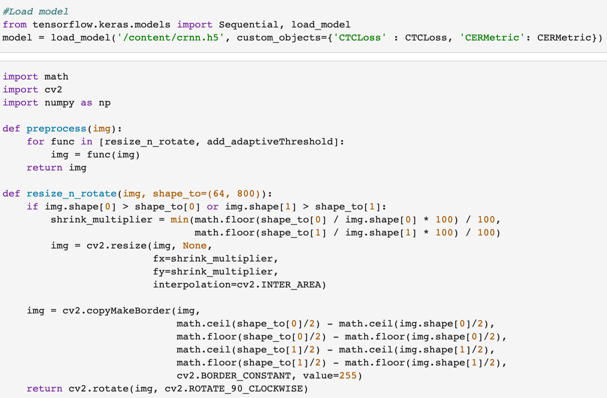
TrainingModel
results
Jambulov Javokhir 12204567

Slide 59
TrainingModel
results
Jambulov Javokhir 12204567

Slide 60
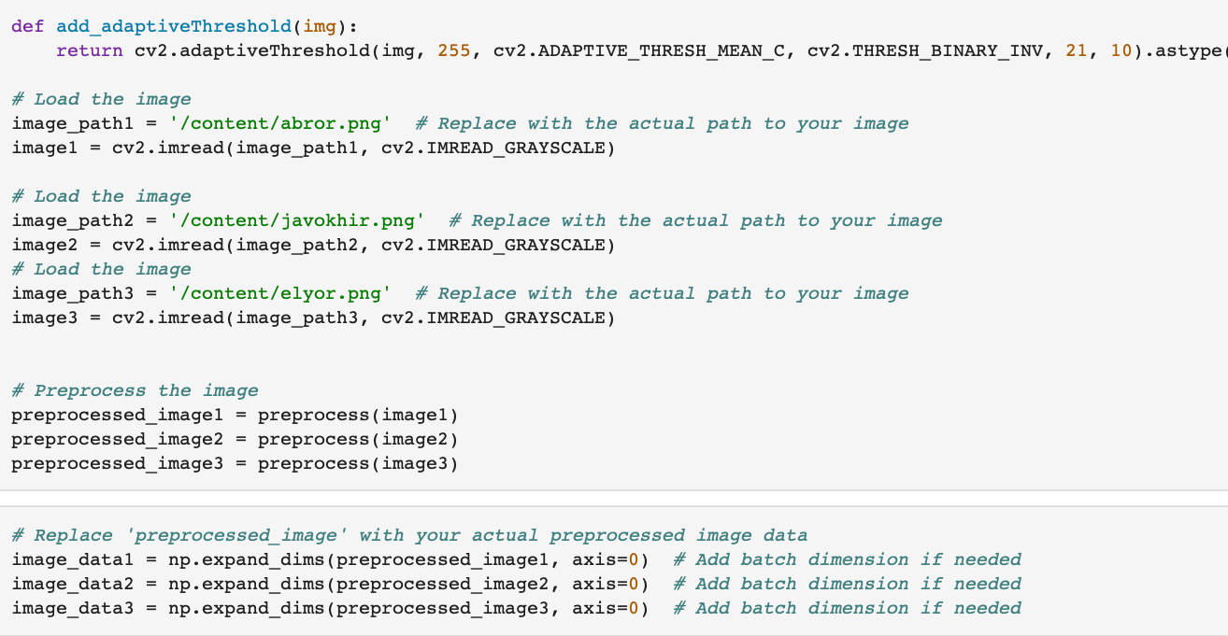
TrainingModel
results
Jambulov Javokhir 12204567

Slide 61
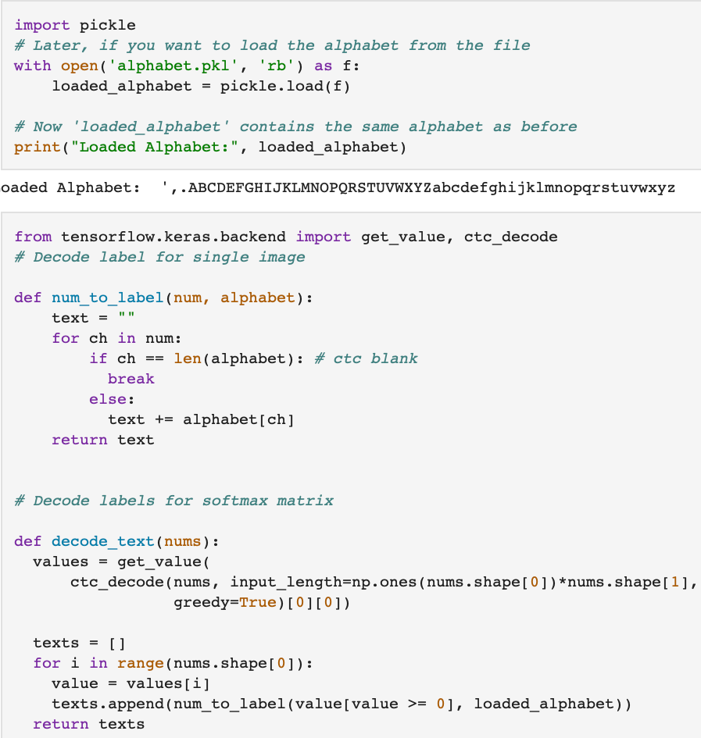
TrainingModel
results
Jambulov Javokhir 12204567

Slide 62
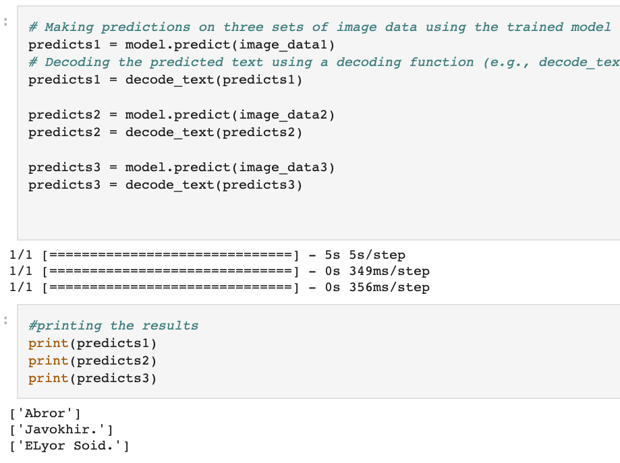
TrainingModel
results
Jambulov Javokhir 12204567

Slide 63
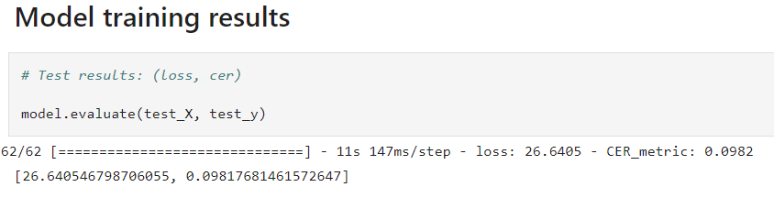
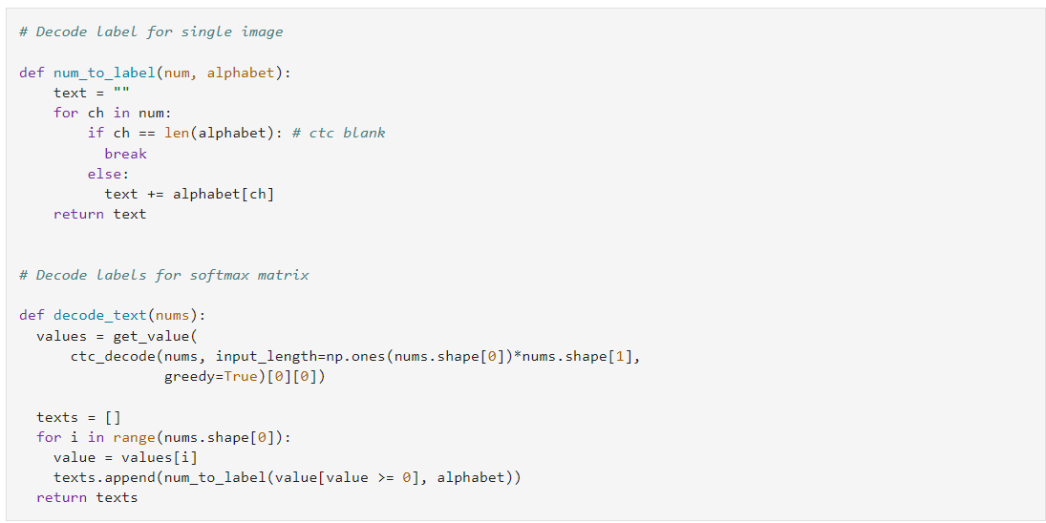
TrainingModel
results
Jambulov Javokhir 12204567

Slide 64
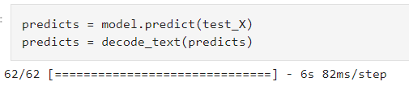
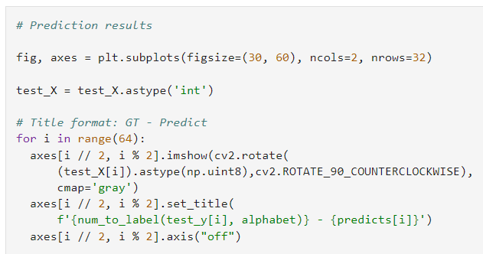
TrainingModel
results
Jambulov Javokhir 12204567

Slide 65
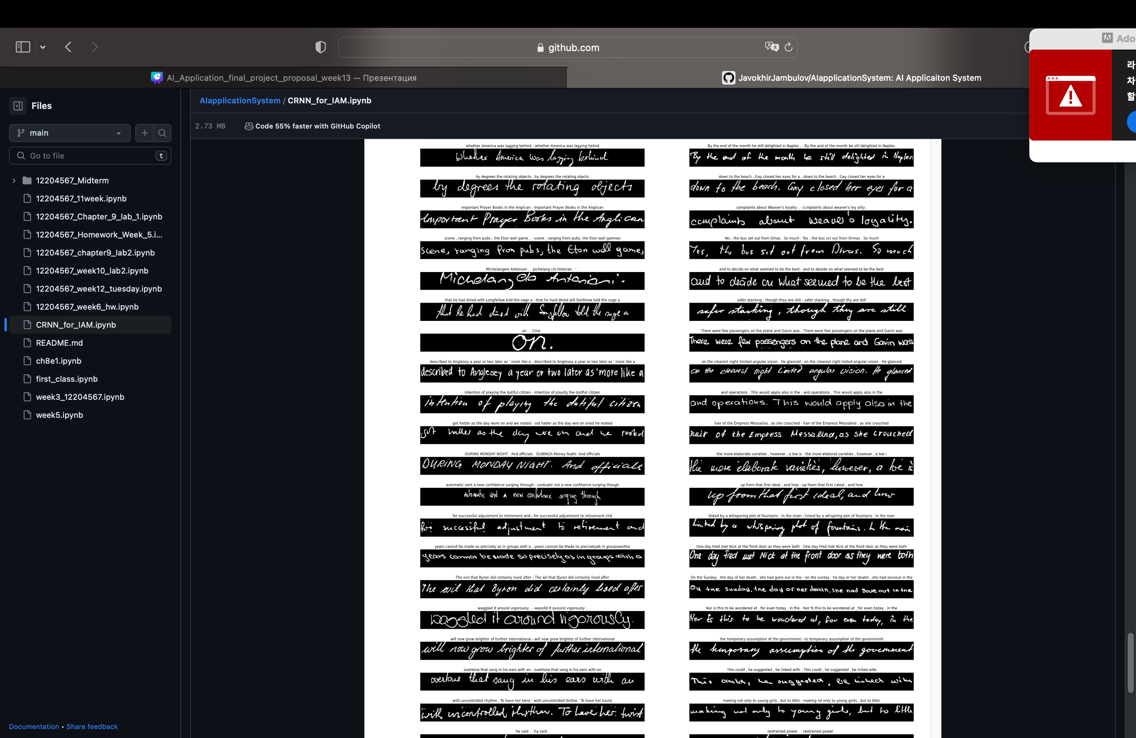
Training
Model
Results
Jambulov Javokhir 12204567

Slide 66
Training
Model
Results
Jambulov Javokhir 12204567

Slide 67
1) https://nanonets.com/blog/handwritten-character-recognition
2) https://www.v7labs.com/blog/handwriting-recognition-guide
References
3) https://data-flair.training/blogs/python-deep-learning-project-handwritten-digit-recognition/
https://github.com/ElyorS/AI_Application_Final_exam/tree/main

Slide 68
THANK YOU!
Calle Cualquiera 123, Cualquier Lugar

